Slide 1
FACE ATTENDANCE SYSTEM
NAME : PAL ABHISHEK MAHESHBHAI
PID: MS23101
PROJECT GUIDE: TULSI M. SHAH

Slide 2
INDEX
Project Profile
Introduction to Organization
Introduction to Project
Objective of the System
Software & Hardware Requirement
System Modules & Functionalities
System Design Diagrams
Data Dictionary
Conclusion

Slide 3
Project profile
Project Name | Face Attendance System
Team Size | Individual Project
Technology Stack | Python,Django,HTML,CSS (Bootstarp 5),SQLite
Development Tools | Visual Studio Code , SQLite Browser

Slide 4
Introduction To Organization
Name of the Organization | WayToWeb Pvt Ltd
Organization Address | 405, 3rd EYE Building 2, Above McDonald's, Near Joyalukkas, Opp. Parimal Garden, Panchavati Cross Road, Ambawadi, Ahmedabad - 380006, Gujarat, India
Website | www.waytowebgroup.com
Working on Platforms and Technologies | Python, AI, ML, web development, SEO, Digital Marketing, ASP .NET, Java, PHP, Odoo, WordPress
Overview of company | WayToWeb Pvt Ltd (an ISO 9001 citified company) is a professionally managed team of developers and designers who love to take your business sky-high with the most innovative approach and ideas
Company Guide Details
Name | Dhyan Patel
Designation | HR Manager
Email ID | Dhyanpatel509@gmail.com
Contact No | 7984425791

Slide 5
Introduction to project
What is a Face Recognition Attendance System?
A Face Recognition Attendance System is an automated method of recording attendance by identifying and verifying an individual’s face using advanced image processing and facial recognition technology. It replaces traditional attendance systems, such as manual sign-ins, ID cards, or fingerprint scanning, with a more sophisticated, efficient, and contactless solution.
Why is a Face Recognition Attendance System Needed?
The need for a Face Recognition Attendance System arises from the limitations and challenges associated with traditional attendance management methods. Here are some key reasons why implementing such a system is essential: Elimination of Manual Errors Prevention of Proxy Attendance Time-Saving and Efficient Real-Time Monitoring and Reporting Reliability and Accuracy

Slide 6
Objective of the system
Automate Attendance Marking
Ensure Accuracy and Reliability
Enhance Security and Prevent Proxy Attendance
Improve Efficiency and Save Time
Enable Real-Time Monitoring and Reporting
Integrate with Other Systems
Promote Contactless and Hygienic Solutions
Improve Data Management and Accessibility
Reduce Operational Costs

Slide 7
Functional and Non-Functional Requirements
Functional Requirements User Authentication Face Detection and Recognition Attendance Marking Data Storage and Management Report Generation Real-Time Monitoring Data Backup and Recovery
2. Non-Functional Requirements Performance Accuracy Reliability Usability Security Scalability

Slide 8
Hardware and Software Requirements
HARDWARE REQUIREMENTS
Camera | Purpose: Capture clear images/videos for accurate face recognition.
Server/PC | Processor: Intel i5 or higher (for fast image processing). RAM: Minimum 8 GB (preferably 16 GB for larger systems). Storage: At least 500 GB HDD or SSD (for storing attendance data and face images).
Peripheral Devices | Monitor: For real-time monitoring and dashboard display. Keyboard and Mouse: For system interaction and administration

Slide 9
Software Requirements
Operating System | Windows 11 (64-bit)
Programming Languages | Python 3.x: For developing the core system and integrating libraries.
Libraries and Frameworks | OpenCV: For image processing and face detection. Dlib: For facial feature extraction. Face Recognition: For recognizing and comparing faces. Numpy: For numerical computations. PIL (Pillow): For image handling.
Database Management System (DBMS) | SQLite: For storing attendance records and user data.
Web Framework | Django: For building web applications.
Development Environment | IDE: PyCharm, Visual Studio Code, or Jupyter Notebook.
Other Tools | CMake: For building and compiling Dlib.

Slide 10
System Modules and Functionalities
MODULES | FUNCTIONALITIES
User Registration and Management Module | Capture and store user face data (images or videos). Register new users by saving their facial features and personal details (name, ID, etc.). Update user information (e.g., name or designation).
Face Detection and Recognition Module | Detect faces from real-time video streams or images. Display the recognized user's information on the screen.
Attendance Marking Module | Automatically mark attendance when a face is recognized. Record the time and date of attendance. Avoid duplicate attendance entries within a specific time frame. Mark attendance as "Present" or "Absent" based on recognition.

Slide 11
Database Management Module | Store user data, face embeddings, and attendance records. Maintain the integrity and security of data. Perform CRUD (Create, Read, Update, Delete) operations on the database. Generate attendance reports and summaries.
Reporting and Analytics Module | Generate daily, weekly, and monthly attendance reports. Visualize attendance data using charts and graphs. Export reports to formats like Excel, CSV, or PDF. Analyze attendance trends and patterns.

Slide 12
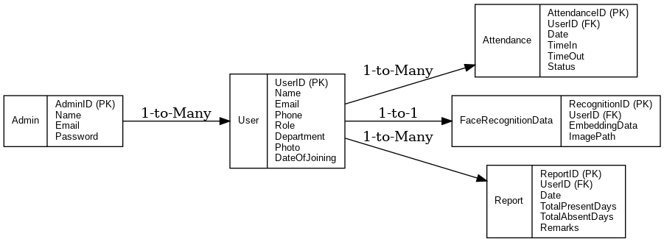
system design diagrams
Entity-Relationship Diagram (ERD)

Slide 13
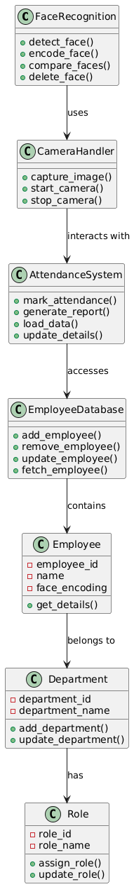
2. Class Diagram (UML)

Slide 14
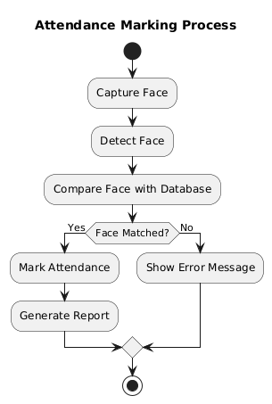
3. Activity Diagram
Attendance Marking Process

Slide 15
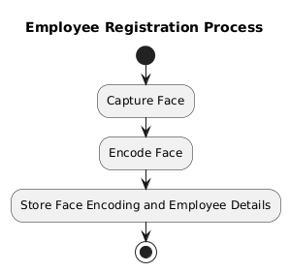
3. Activity Diagram
Employee Registration Process

Slide 16
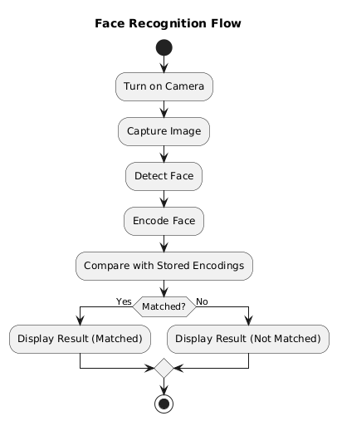
3. Activity Diagram
Face Recognition Flow

Slide 17
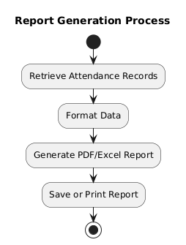
3. Activity Diagram
Report Generation Process

Slide 18
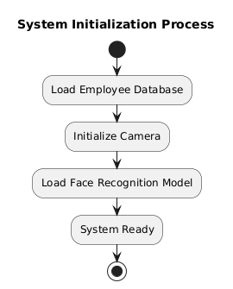
3. Activity Diagram
System Initialization Process

Slide 19
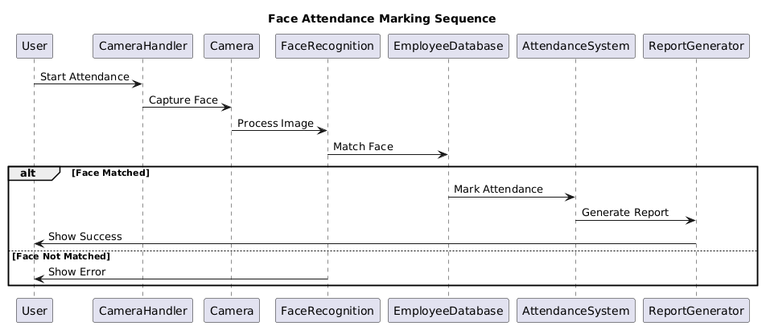
4. Sequence Diagram
Face Attendance Marking Sequence

Slide 20
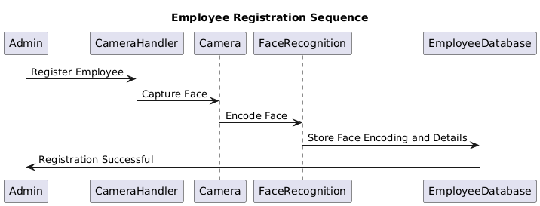
4. Sequence Diagram
Employee Registration Sequence

Slide 21
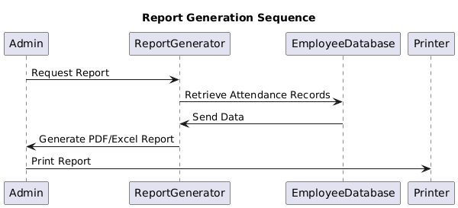
4. Sequence Diagram
Report Generation Sequence

Slide 22
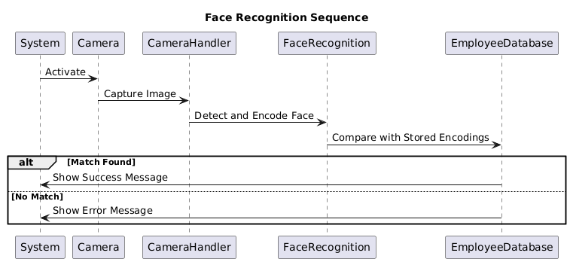
4. Sequence Diagram
Face Recognition Sequence

Slide 23
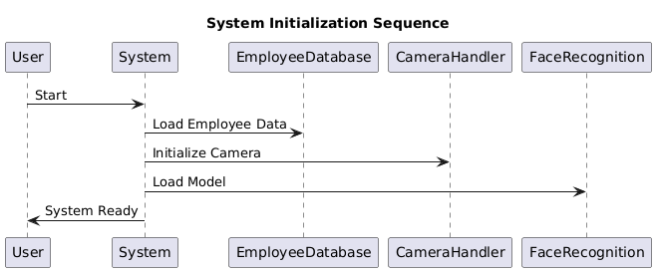
4. Sequence Diagram
System Initialization Sequence

Slide 24
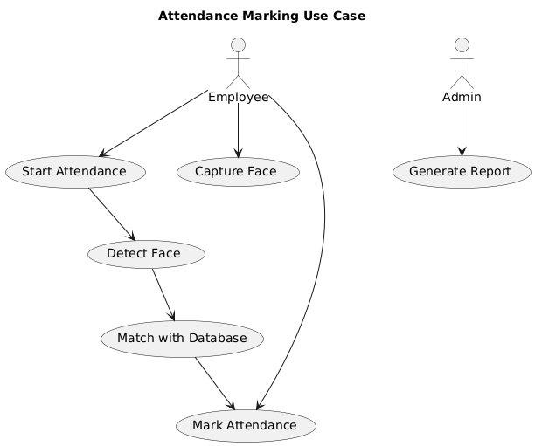
Use Case Diagram
Attendance Marking Use Case

Slide 25
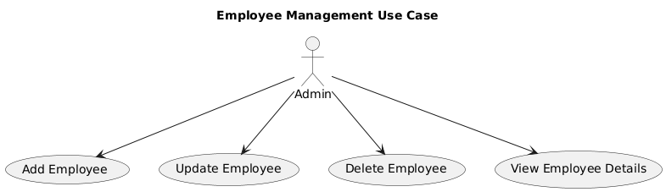
Employee Management Use Case

Slide 26
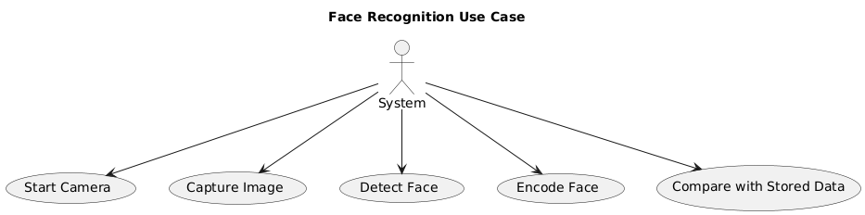
Face Recognition Use Case

Slide 27
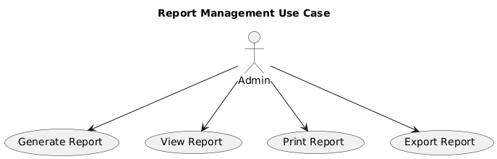
Report Management Use Case

Slide 28
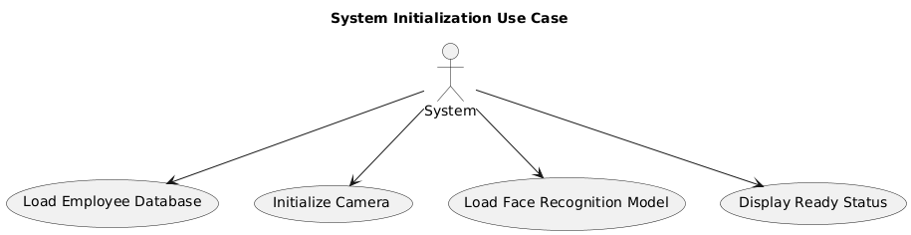
System Initialization Use Case

Slide 29
Data Dictionary
1. Employee Table
Attribute | Data Type | Description
employee_id | INT | Unique identifier for each employee
name | VARCHAR | Full name of the employee
department_id | INT | Foreign key referencing Department table
role_id | INT | Foreign key referencing Role table
face_encoding | BLOB | Encoded face data
contact_number | VARCHAR | Contact number of the employee
email | VARCHAR | Email address of the employee

Slide 30
2. Department Table
Attribute | Data Type | Description
department_id | INT | Unique identifier for each department
department_name | VARCHAR | Name of the department

Slide 31
3. Attendance Table
Attribute | Data Type | Description
attendance_id | INT | Unique identifier for each attendance record
employee_id | INT | Foreign key referencing Employee table
date | DATE | Date of attendance
time_in | TIME | Time when the employee checked in
time_out | TIME | Time when the employee checked out
status | VARCHAR | Attendance status (Present, Absent, etc.)

Slide 32
4. Attendance Report Table
Attribute | Data Type | Description
report_id | INT | Unique identifier for each report
report_date | DATE | Date when the report was generated
total_present | INT | Total number of employees present
total_absent | INT | Total number of employees absent
remarks | TEXT | Additional remarks or notes

Slide 33
Conclusion
The Face Recognition Attendance System offers an efficient, secure, and automated way to mark attendance using face recognition technology. It eliminates the need for traditional manual methods, reduces human errors, and enhances the overall accuracy and speed of attendance tracking. With features like real-time face detection, automatic attendance marking, and detailed reporting, the system significantly improves workplace management. Its integration with databases ensures secure storage and easy retrieval of attendance records. Additionally, the use of face recognition minimizes proxy attendance and enhances overall security.

